Slide 1

MEDIA DAY
Sunday June 7, 2026
9 AM to 12 PM
OPEN HOUSE

Slide 2
Media Day-vital for a successful season
Athletes will be measured for their helmets, shoulder pads and uniforms
Athletes will have the opportunity for a FREE Baseline Concussion test provided by Kessler Rehabilitation Center physical therapists. Coaches will have these baselines for comparison if there are any injuries.
Team moms will be collecting paperwork for book check
Book check requires a signed copy of your athlete’s birth certificate – so bring your original & we can make a copy that day or bring a colored copy
Pop Warner specific paperwork – links on registration page
Physicals
Report Cards – if your child does not have the end of year report card yet, you will just bring that on the first practice

Slide 3
MEDIA DAY IS ALSO FUN
There will be a DJ all day and some awesome food trucks (yum)
On the football field we will have Free combine drills set up for everyone to test their abilities
Laser tag will be on the baseball field – this will have a $10 charge for unlimited turns
This will be the only day that you can request your number for your jersey
Awesome photo ops

Slide 4

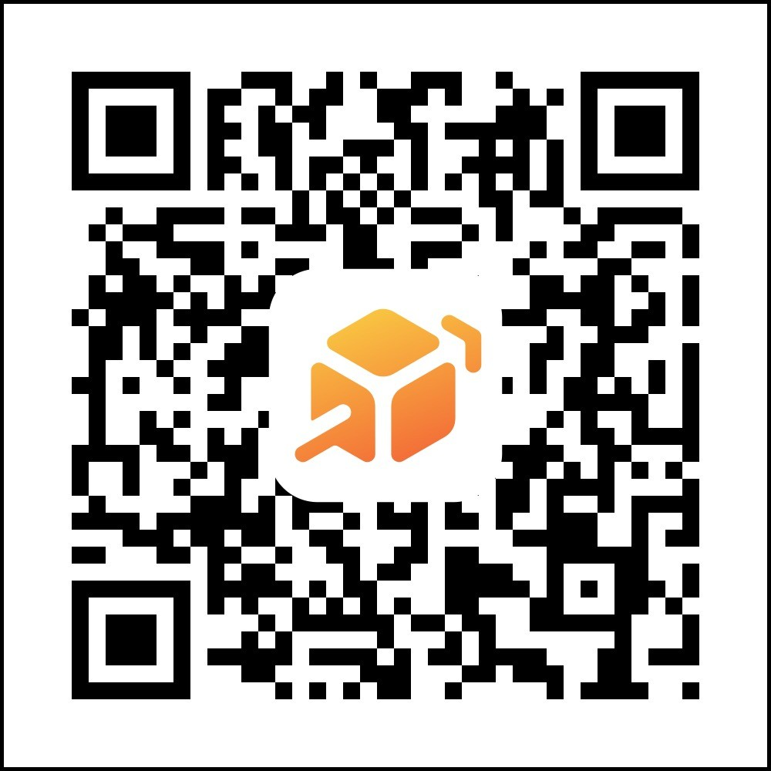

AC Photography
Scan the link to sign up for photos – your athlete can wear any swag or drip they have or we will have some jerseys and props available for fun pictures. There will be a book to scan through for pose ideas too. Spots are limited so signing up in advance is recommended!!

